Slide 1
Digital Portfolio
STUDENT NAME: G.kirtheesh
REGISTER NO AND NMID: 222404564/ asunm130124j023
DEPARTMENT: Bsc Software Application
COLLEGE: COLLEGE/ UNIVERSITY: A.M.Jain College

Slide 2
PROJECT TITLE
DIGITAL
PORTFOLIO

Slide 3


AGENDA
Problem Statement
Project Overview
End Users
Tools and Technologies
Portfolio design and Layout
Features and Functionality
Results and Screenshots
Conclusion
Github Link
3/21/2024 Annual Review

Slide 4

PROBLEM STATEMET 1)Building the structure 2)Giving perfect colors 3)Inserting pictures 4)Making Scrolling smooth 5)Making it Responsive

Slide 5
PROJECT OVERVIEW A Digital Portfolio fully attached about my skills in the software world and also it holds my project i have linked my github , linkedin ,Twitter profile

Slide 6

WHO ARE THE END USERS?
The End Users are..
The Companies I go for Interview
My Online Clients

Slide 7

TOOLS AND TECHNIQUES
HTML
css
JAVASCRI PT

Slide 8
POTFOLIO DESING ANG LAYOUT
It has a maginificent Purple blended violet colors and it has my profile photo , My name in the Starting
after scrolling down you can find my projects , and what Skills do i have and lastly you got a information box
to fill up your details and get in touch with me...
- Thank you!!

Slide 9
FEATURES AND FUNCTIONALITY

Slide 10


FEATURES AND FUNCTIONALIT
Displays My Essential Details
Scrolls Smootly
it has a Arrow button in the left to scroll up from down

Slide 11
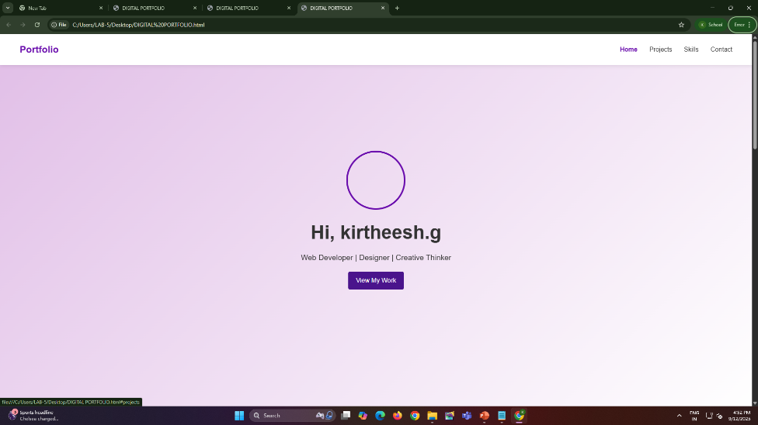
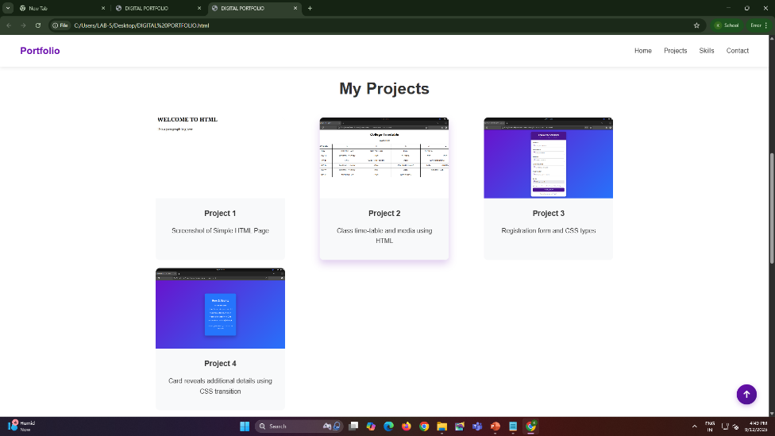

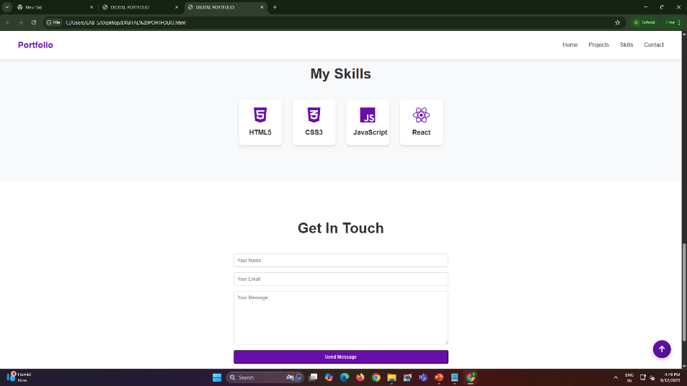
RESULTS AND SCREENSHOTS
3/21/2024 Annual Review
11

Slide 12
CONCLUSION
I have created this Portfolio with my Hardwork and
consistency
12

